Slide 1
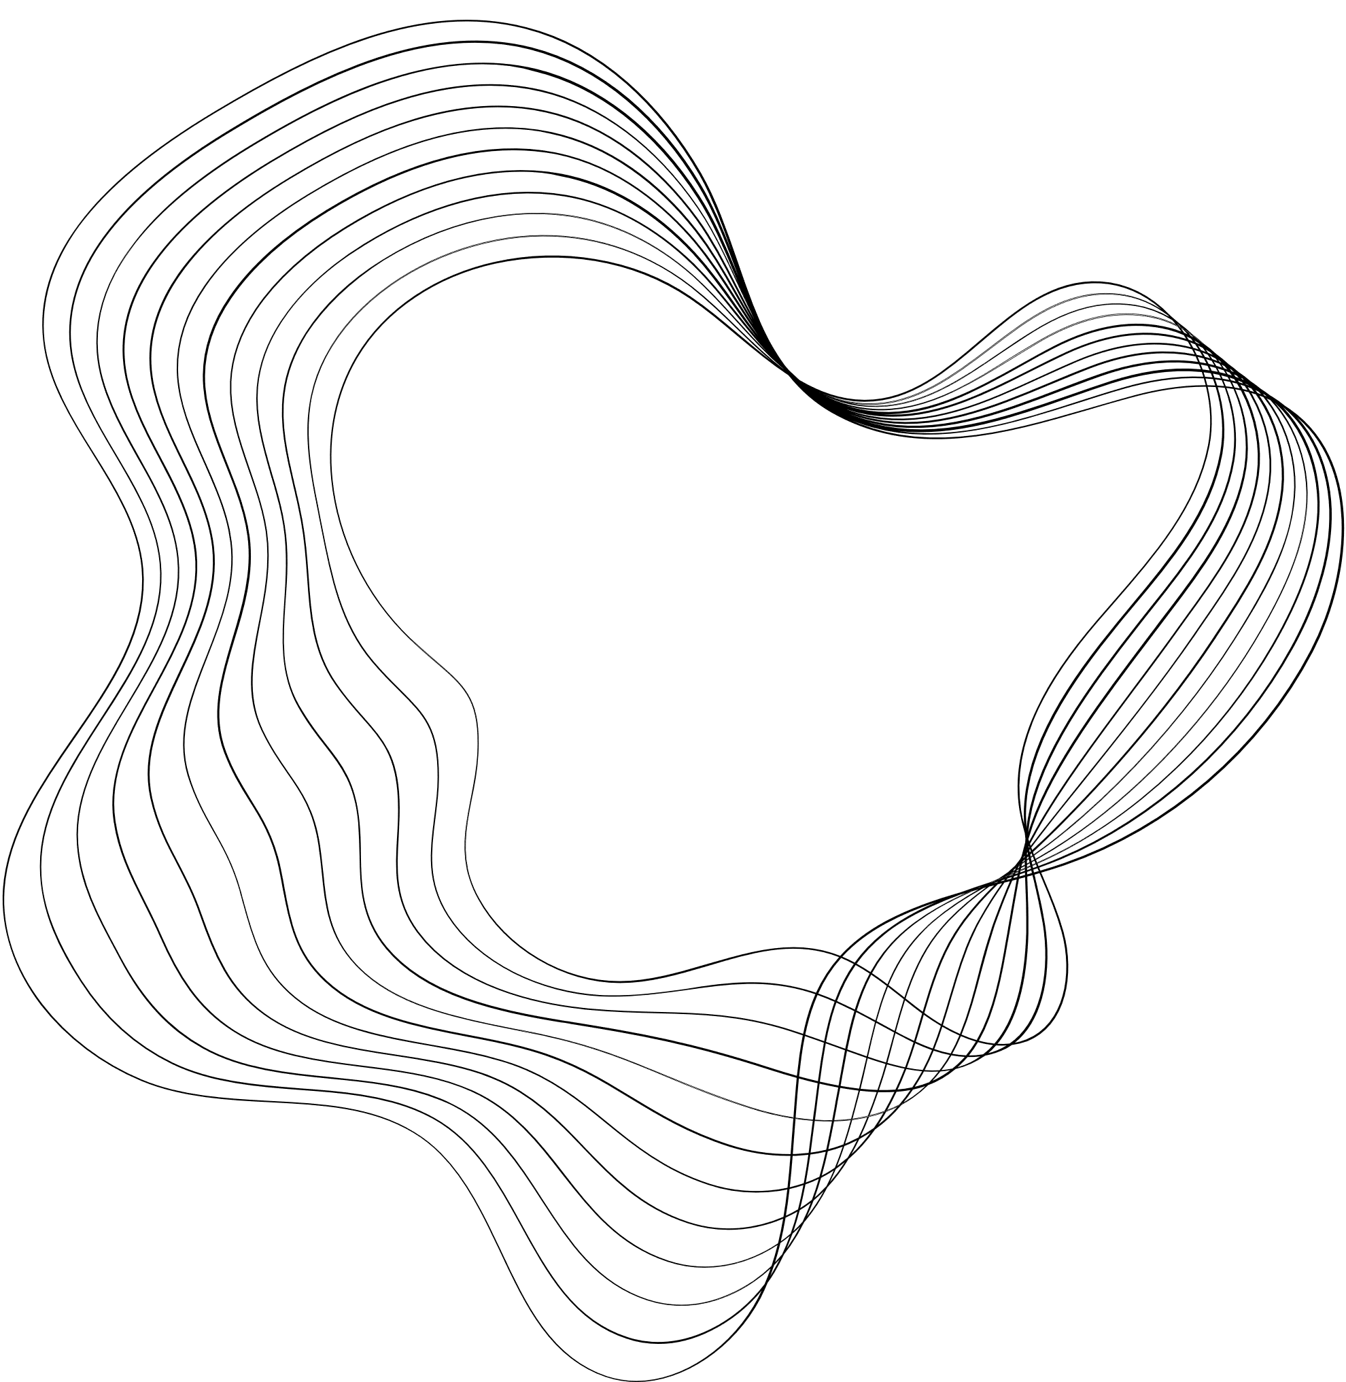

Presentation On
Web 3.0 and Blockchain Based Decentralized Social Connectivity Web Application
By:
Mili Srivastava (205433)
Rachit Bharadwaj (205445)
Under The Guidance Of
Mr. Pravin Kumar Pandey
Department Of Computer Science Engineering And Information Technology
UNSIET VBSPU Jaunpur

Slide 2

OUTLINE
01
INTRODUCTION
02
SCOPE AND OBJECTIVE
03
TECHNOLOGY STACK
04
ARCHITECTURE
05
PROCESS FLOW
06
BENEFITS OF WEB3
07
CONCLUSION

Slide 3






INTRODUCTION
Centralized social media lacks privacy, content ownership, and invites arbitrary censorship, urging a decentralized solution.
Our Next.js, Solidity, MongoDB, and IPFS-based platform prioritizes privacy, grants content ownership, and ensures a censorship-resistant environment.
Integrating technologies, our platform provides data control, enhanced security, and a democratic, user-centric social media experience.

Slide 4





SCOPE AND OBJECTIVES
Scope
Objective 1
Objective 2
Develop user-centric social media with Next.js, Solidity, MongoDB, and IPFS, focusing on privacy, content ownership, and censorship resistance.
Implement robust security via Ethereum smart contracts, ensuring encrypted data storage and transparent interactions for user trust.
Enable users with enhanced digital autonomy using IPFS for decentralized storage, ensuring ownership and control over data and interactions.

Slide 5

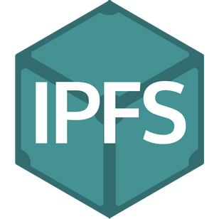





TECHNOLOGY STACK
React framework for scalable web apps, ensuring a seamless user interface.
Decentralized protocol for secure, resilient storage and sharing of content.
Secure language for decentralized app development on Ethereum blockchain.
For ensuring secure and transparent transactions in our decentralized social media platform.
NoSQL database for flexible and scalable user data storage.
Ethereum's go-to framework for streamlined smart contract development, testing, and deployment.

Slide 6
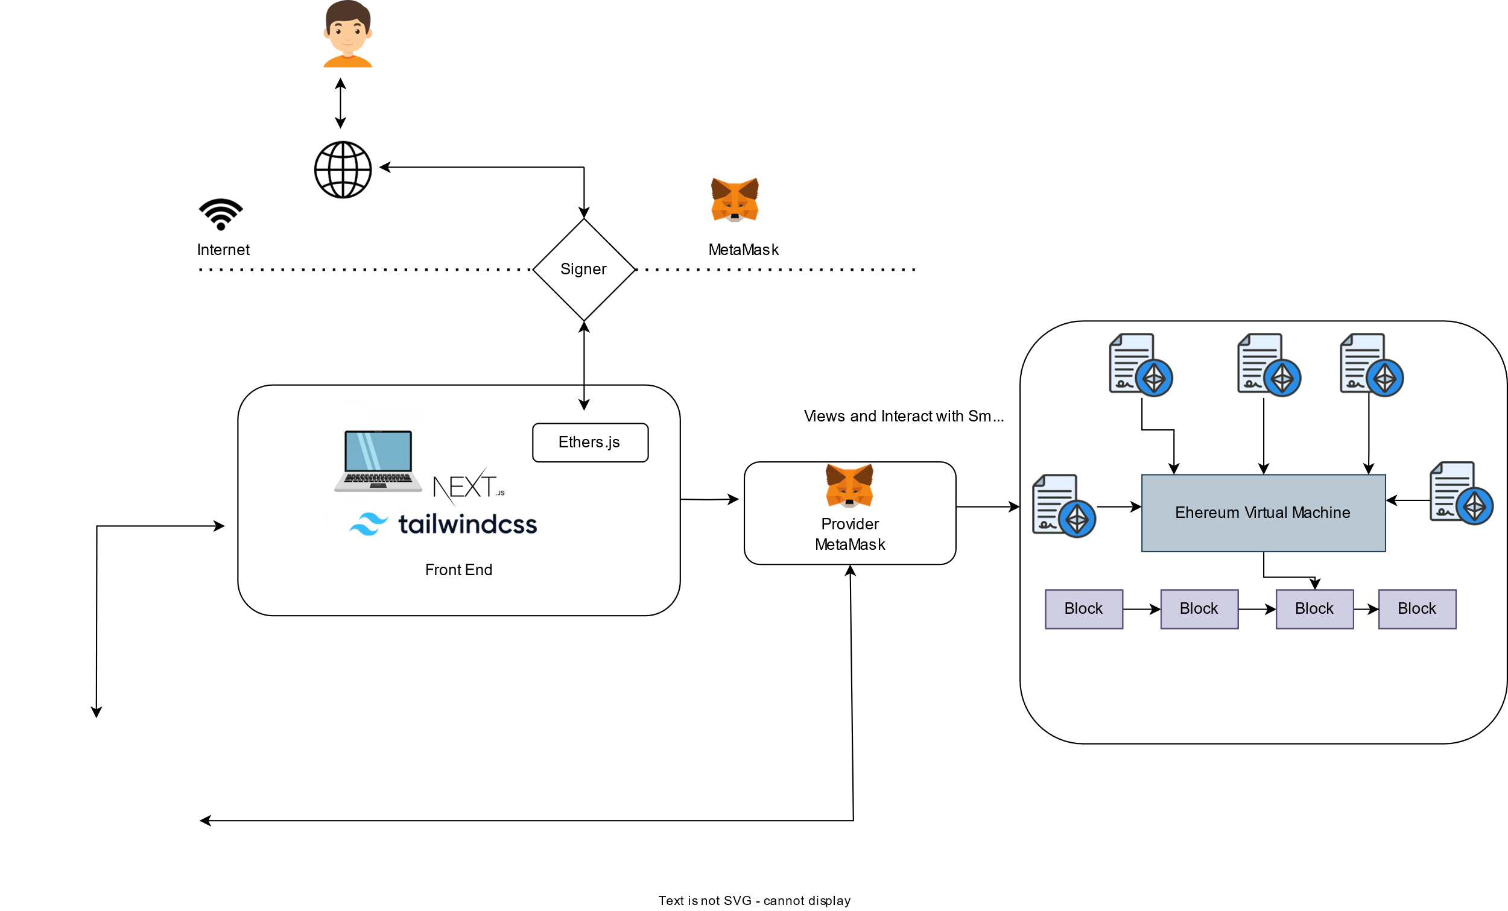
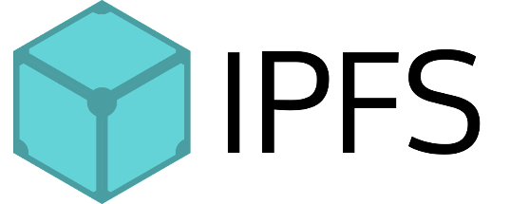
ARCHITECTURE

Slide 7
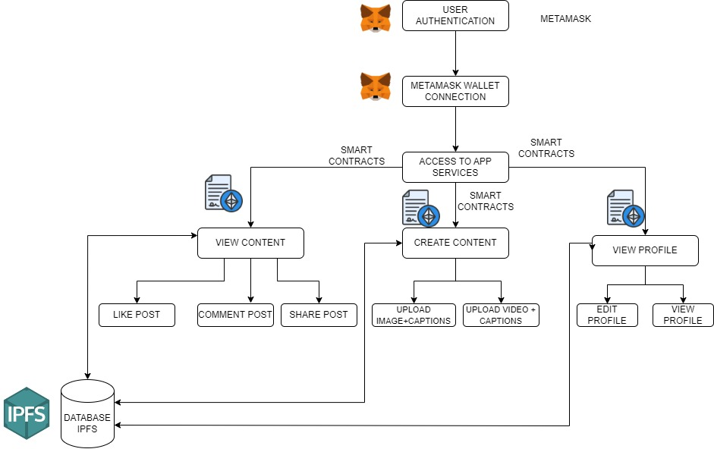
PROCESS FLOW

Slide 8
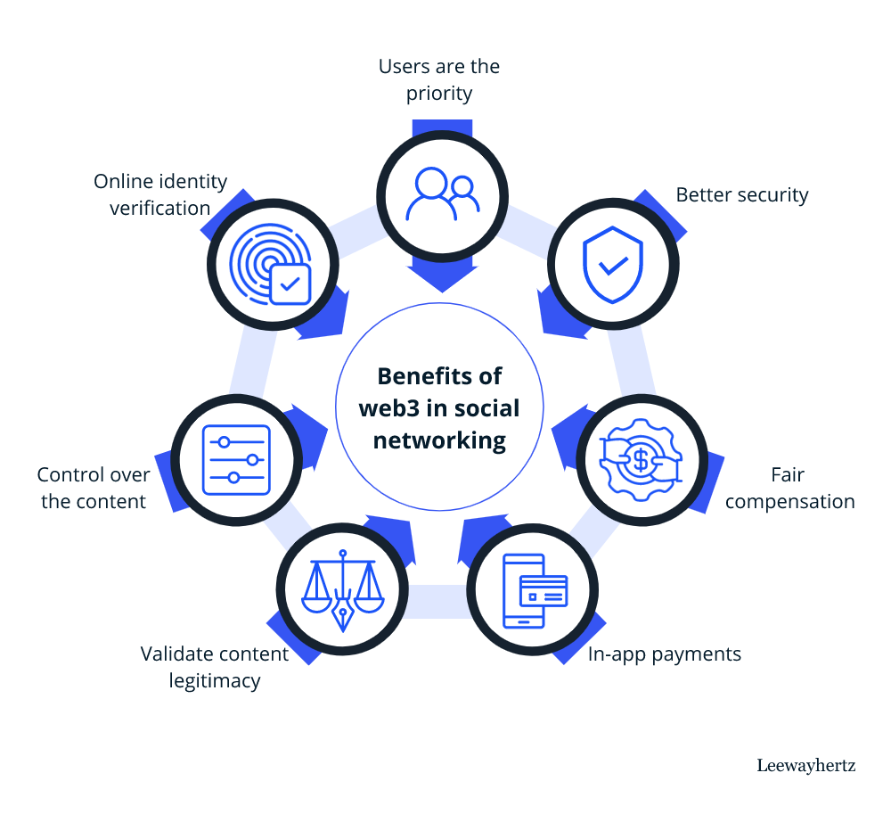
BENEFITS OF WEB 3.0
STRATEGY N°3

Slide 9
CONCLUSION
Surpassing Web 2.0, our decentralized platform ensures superior user privacy and content ownership, reshaping digital interactions.
Next.js, Solidity, MongoDB, and IPFS empower users with unprecedented control, departing from centralized norms.
Paving the way for a user-centric future, our project stands out in its commitment to security and transparency.

Slide 10

THANK'S FOR WATCHING

